Slide 1
Relative Humidity

Slide 2
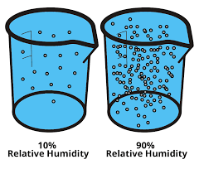
What is Relative Humidity?
Relative Humidity is a ratio between the amount of water vapor currently in the air relative to the amount of water vapor if the air were saturated.
Relative humidity does not tell us anything about the actual water vapor content of the air, only the percent saturation.
A relative humidity of 100% tells us that the air is saturated with water vapor.

Slide 3
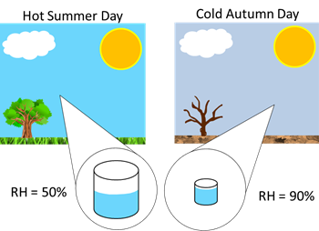
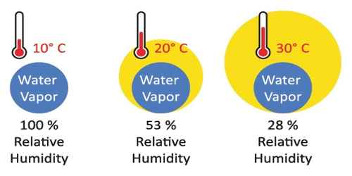
Why is it “Relative”?
The amount of water vapor that can exist in the air before saturation occurs depends on temperature.
Higher temperatures increase the amount of water vapor that can be in the air, without changing the actual amount of water in the air.

Slide 4
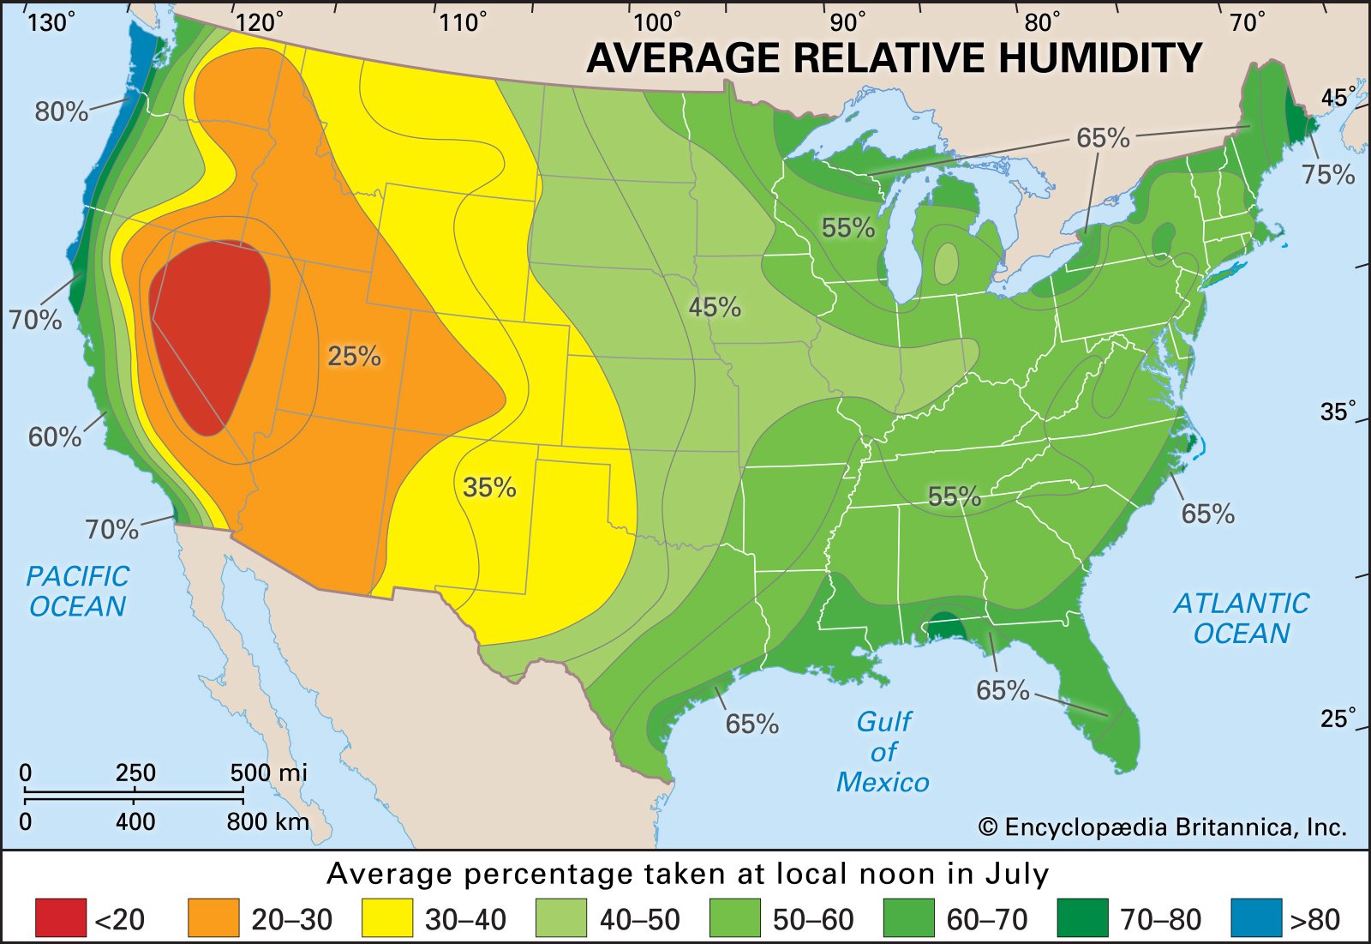
Comparing Relative Humidity
Since relative humidity depends on temperature, it is not a good measure to compare moisture levels at different locations.
High temperature + low moisture =
low relative humidity
Low temperature + moderate moisture =
High relative humidity
High temperature + high moisture =
High relative humidity

Slide 5
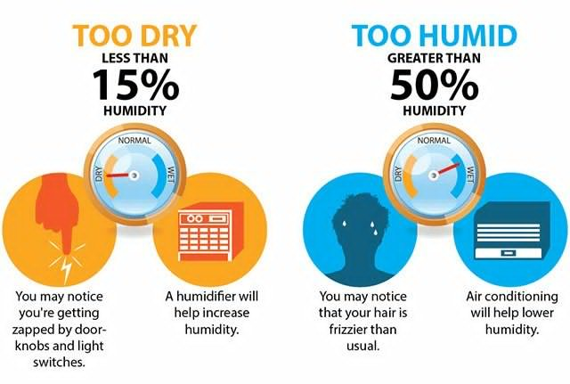
Used by Meteorologists
Relative Humidity is used by meteorologist to communicate how close the air is to saturation, which is important for describing things such as comfort level and the potential for fog.
People tend to feel most comfortable at a relative humidity of between 30% and 50%

